Slide 1
Experience project in data science
Dataset: Adult Income Census
Ohad Lavie - 209805787
Ronen Hristoforov - 318639028

Slide 2



About the Data
The data was extracted from a 1994 database on adult income, showing data on individuals, including if their annual salary was less or more than 50k.
The information on the individuals included: age, workclass, education, marital status, hours per week and more.
We will dive into specific data in the EDA process.

Slide 3
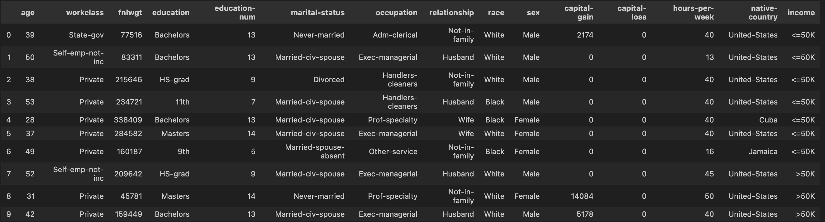
Quick Look at the Data

Slide 4
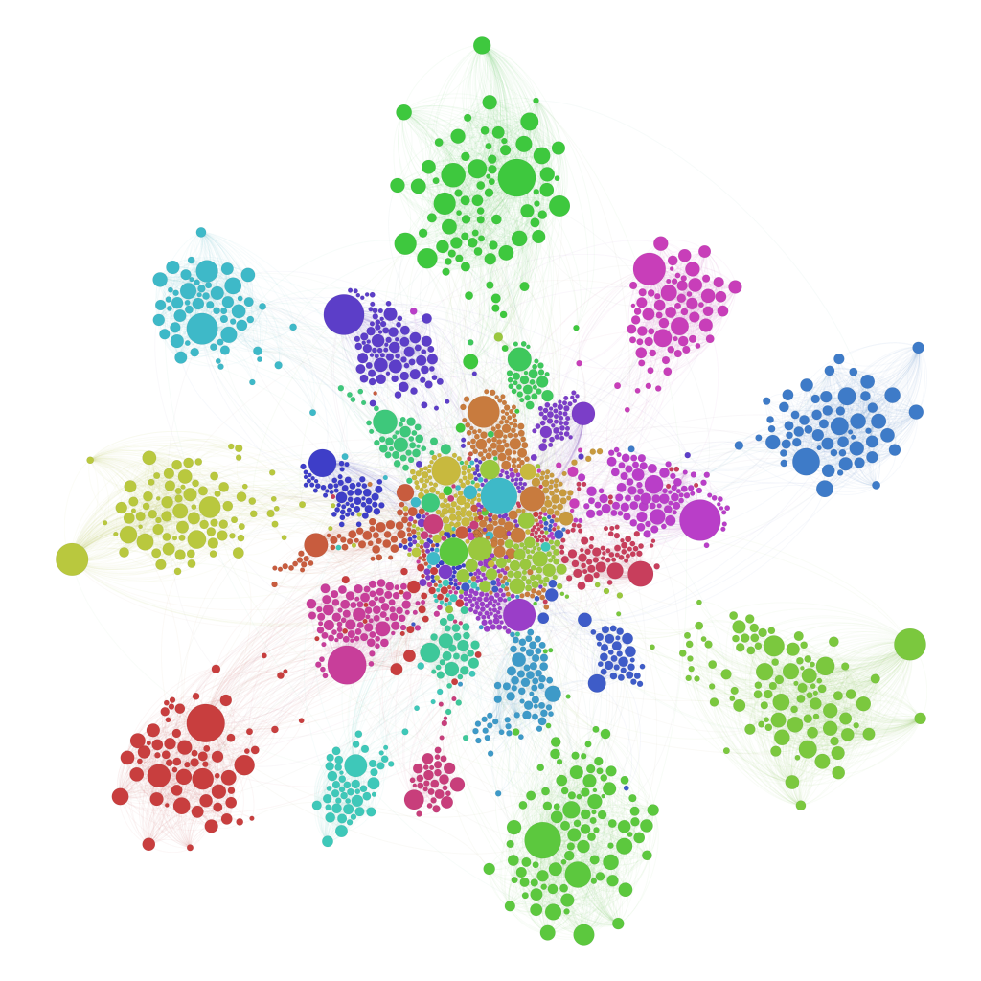
Research question
“How can clustering analysis be applied to population data to form meaningful groups based on employment patterns and education level?”

Slide 5
Workflow
Import
EDA
Visualization
Feature Engineering
Clustering Algorithms
Conclusions

Slide 6
EDA
Exploratory Data Analysis

Slide 7
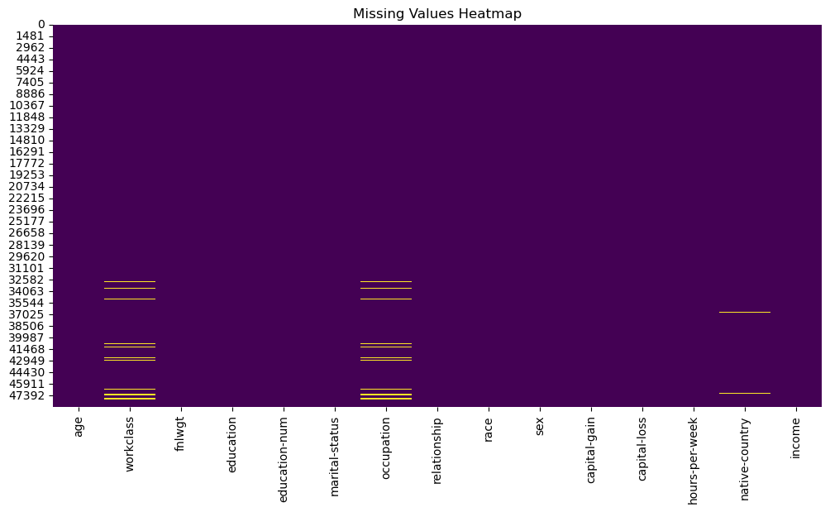
Exploratory Data Analysis
In our Data we have 48842 entries.
We started off by seeing what null values we have.
We could see null values in 3 columns :
Workclass – 963 (~ 1.97%)
Occupation – 966 (~ 1.97%)
Native Country – 274 (~ 0.56%)
We decided to replace those values with ‘missing’ so we could still work on that data , and maybe later infer meaningful insights from the ‘missing’ bucket.

Slide 8
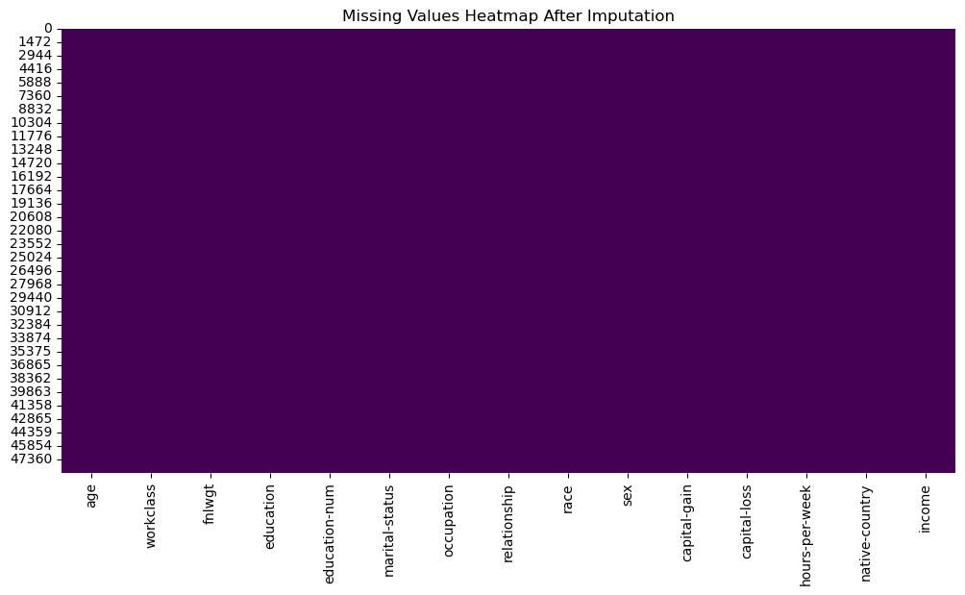
Exploratory Data Analysis
After doing so, we have no null values.

Slide 9
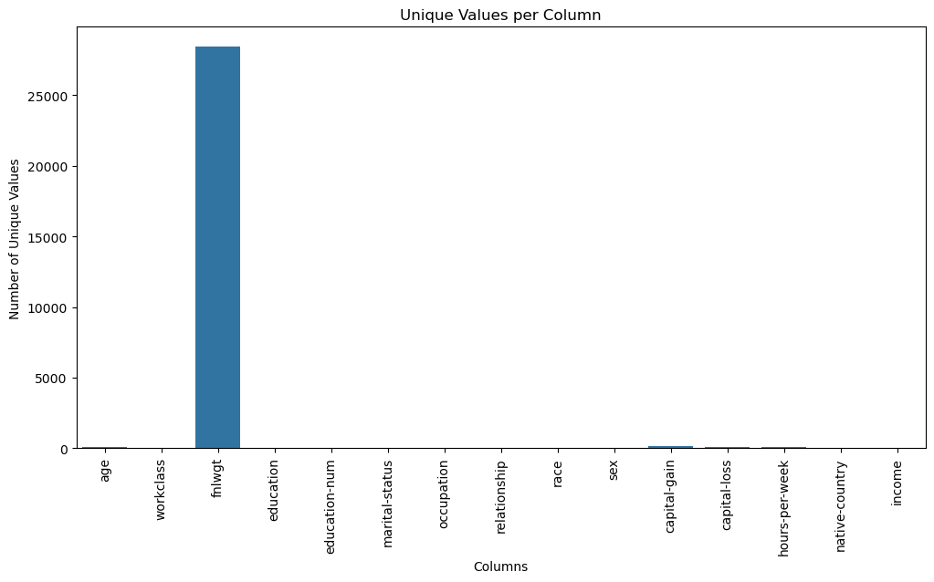
We saw that the column "fnlwgt" looks odd - it has 28k unique value, and after further investigating of it, we decided to drop this column, as we cannot attain meaningful insights from it.

Slide 10
Plotting Categorical Values

Slide 11
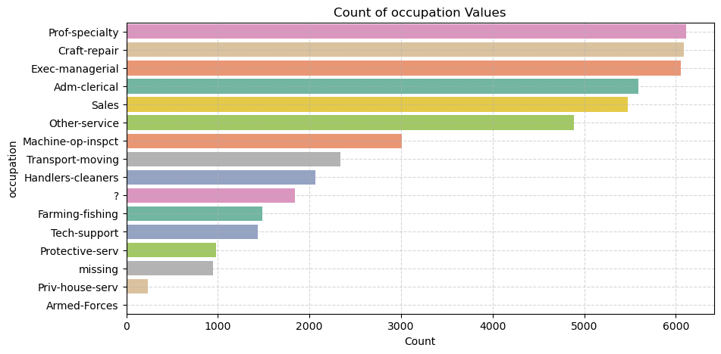
We went to further check the Data for weird values, Most of which were ‘?’.
We didn’t found anomalies like negative age .
Imputing ‘?’ values as ‘missing’

Slide 12
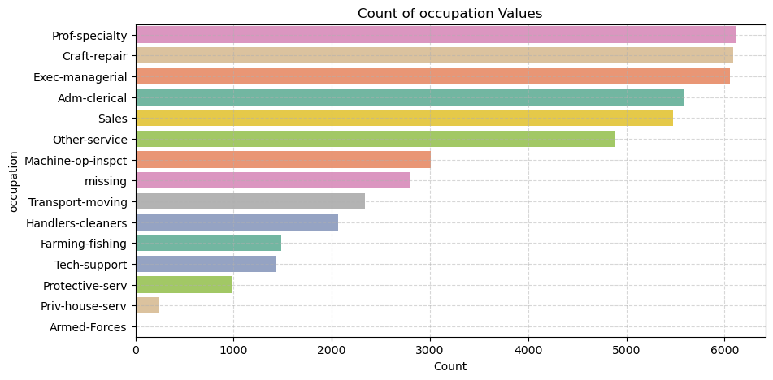
We went to further check the Data for weird values, Most of which were ‘?’.
We didn’t found anomalies like negative age .
Imputing ‘?’ values as ‘missing’

Slide 13
Occupation
Observations :
Top Three Occupations Are Almost Tied :
Prof-specialty (~6,200), Craft-repair (~6,100), and Exec-managerial (~6,000) are the most frequent categories, each appearing in roughly 6 K of the ~48 K rows. Together, those three alone make up about 37 % of all records.
In other words, more than third of the dataset works in professional specialties, crafts/repairs, or executive/managerial roles.
Mid‐Tier Occupations:
Adm-clerical (~5,500) and Sales (~5,300) also appear very often (each roughly 5.5–5.3 K).
• Other-service (~4,800) rounds out the “top six” occupations, meaning nearly half of everyone falls into these six job categories.
Long Tail of Less Common Jobs:
• After “Other-service,” counts drop sharply

Slide 14
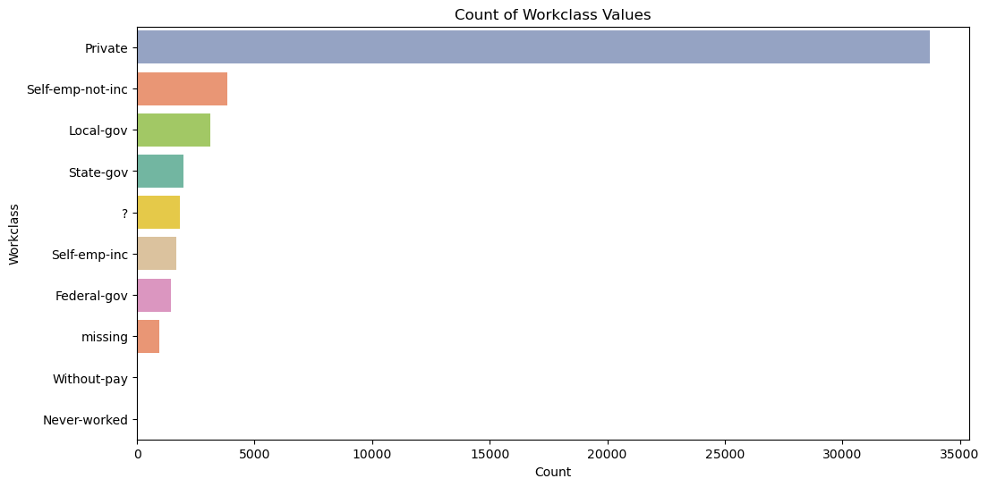
Workclass
Imputing ‘?’ values as ‘missing’

Slide 15
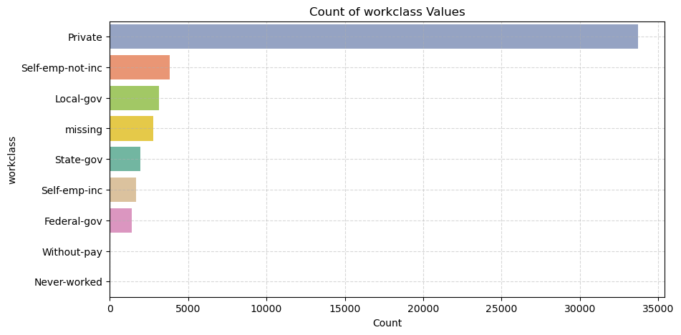
Workclass
Imputing ‘?’ values as ‘missing’
Observations:
Dominance of the Private Sector : Roughly 70% of records list “Private” employment.
“Government” comes second at about 12–14% of the data.
~2,800 “missing” entries (~6% of the Data).
- “Without-pay” and “Never-worked” are extremely scarce (<1%).

Slide 16
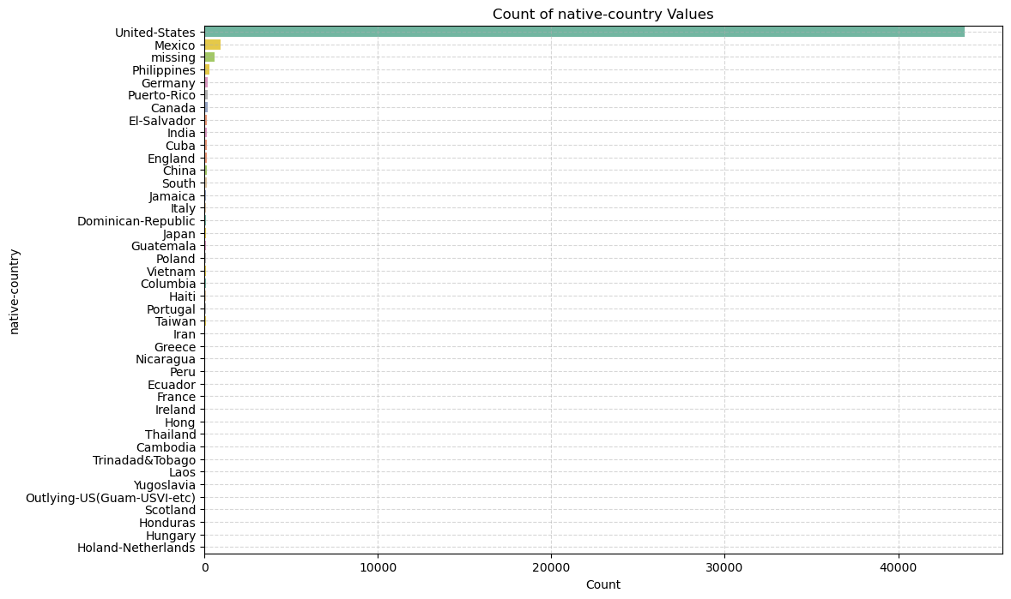


Native Country
Observation :
~91% of the data consists of people from the US
~2% of the data consists of people from Mexico
The rest of the countries have less than 0.6% each of the data.

Slide 17
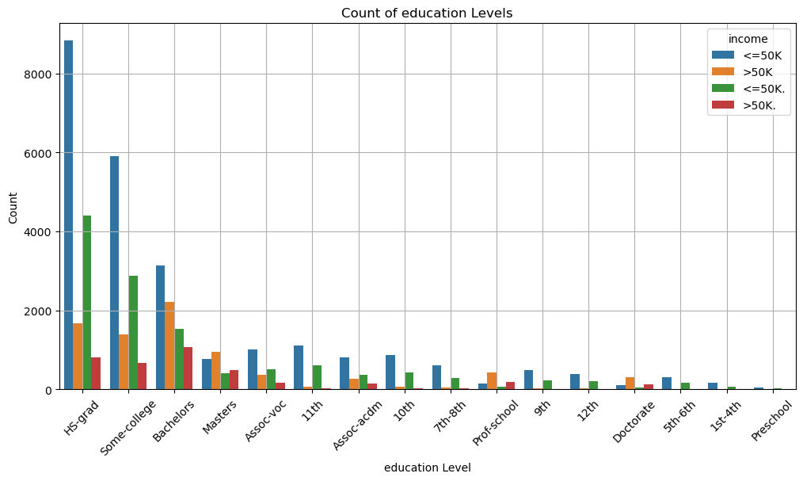
Education
2 identical categories that we will combine
We had 2 columns with the same values, just different names.
We got rid of one of them → ‘Education-num’.

Slide 18
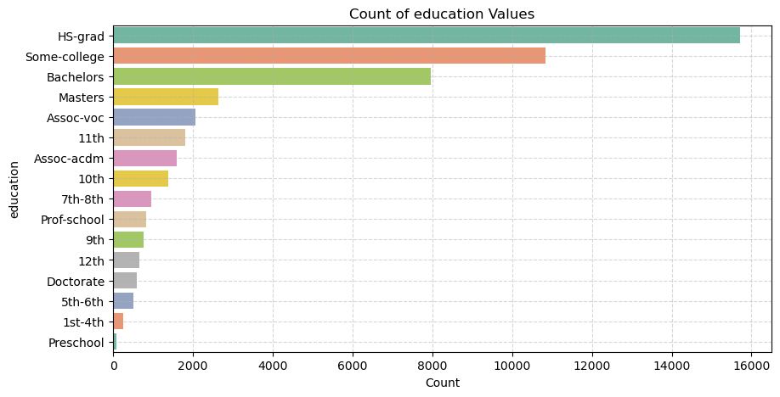
Education
Observations :
- Heavily skewed toward mid-levels
• HS-grad (~15 800, ~32 %) is the single largest bin, followed by Some-college (~11 000, ~22 %) and Bachelors (~8 000, ~16 %).
• Together, those top three account for ~70 % of your sample.
- Clear ordering
• Unlike nominal categorizations, these bins have a strict hierarchy—no need to treat them as unordered factors.
Implications :
- Using ordinal encoding on 'education' column.

Slide 19
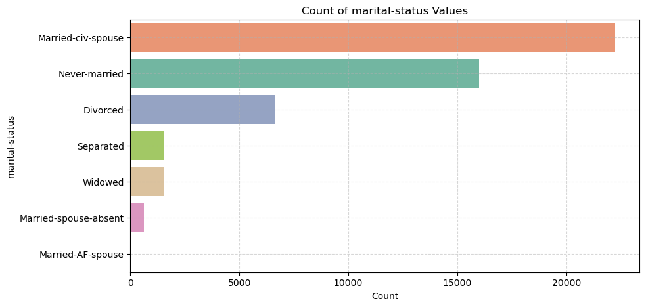
Marital-status
Observations :
- Dominant categories : Married-civ-spouse (~45%) and Never-married (~32.5%) together account for roughly 78% of all records.
- Mid-tier level : Divorced is the only other category in double digits at 13.6%.
- Small minorities : Separated and Widowed each appear in about 3.7% of rows.
- Very rare levels : Married-spouse-absent (~1.2%) and Married-AF-spouse (~0.1%) combined make up barely 1–2%.
Implications :
- Dimensionality reduction : We can group together the very rare categories : Married-spouse-absent,and Married-AF-spouse.

Slide 20
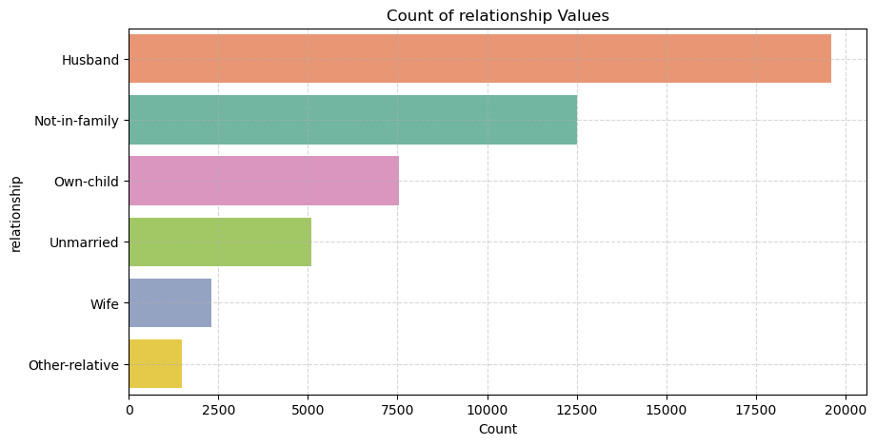
Relationship
Observations :
- Husband is the most common relationship (≈19,800 records, ~40%).
- “Wife” is relatively small (~5%)
Implications
Feature engineering : Group 'Husband' and 'wife' together to 'Spouse'.

Slide 21
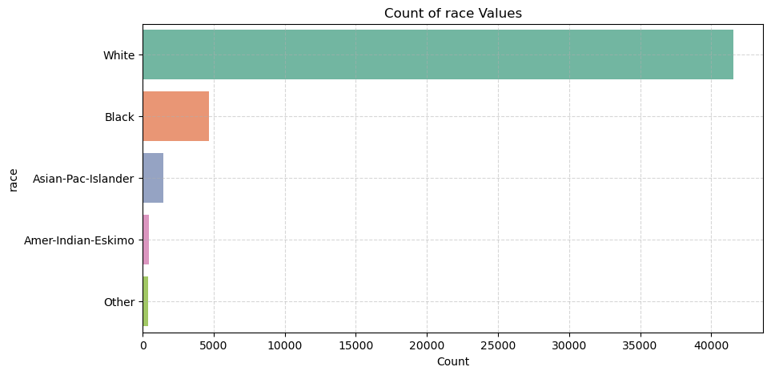
Race
Observations :
Our Data is dominated by 'White' which account for roughly 80–85%.
Asian-Pac-Islander is only 3–4%, while Amer-Indian-Eskimo and Other are each under 1%.
Implications :
Feature engineering : group 'Amer-Indian-Eskimo' and 'Other' into a single “Other-Race” bucket.

Slide 22
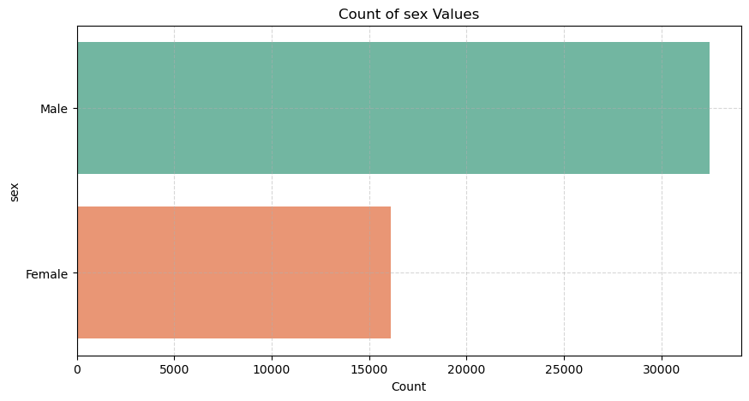
Sex
Observations :
- Male makes up about 67% of the Data.
- Female accounts for the remaining 33%.

Slide 23
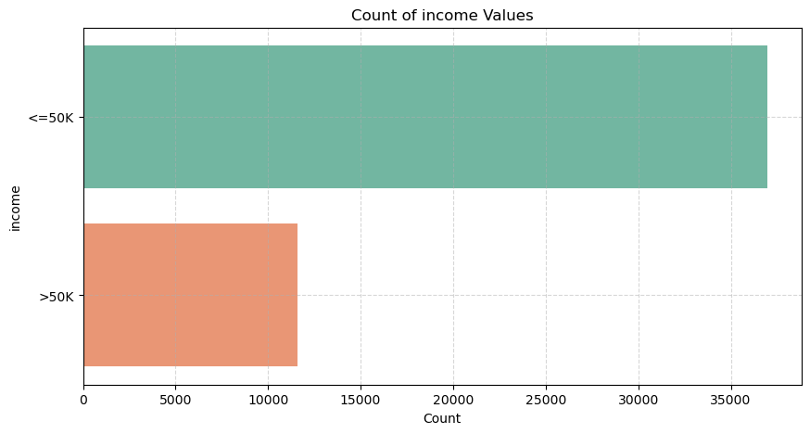
Income
Observations :
“<=50k” constitutes roughly 76% of the data (~37 000 records).
“>50k” makes up only 24% (~11 600 records).

Slide 24
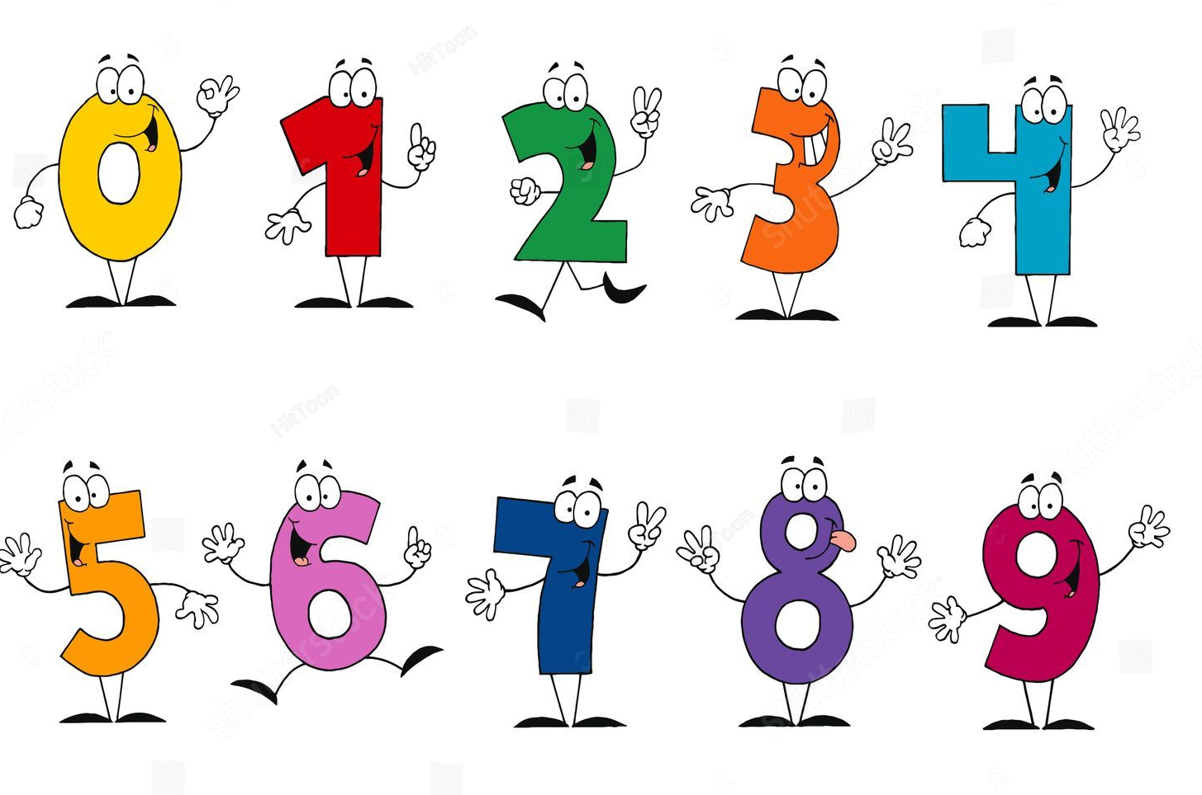
Plotting Numerical Values

Slide 25
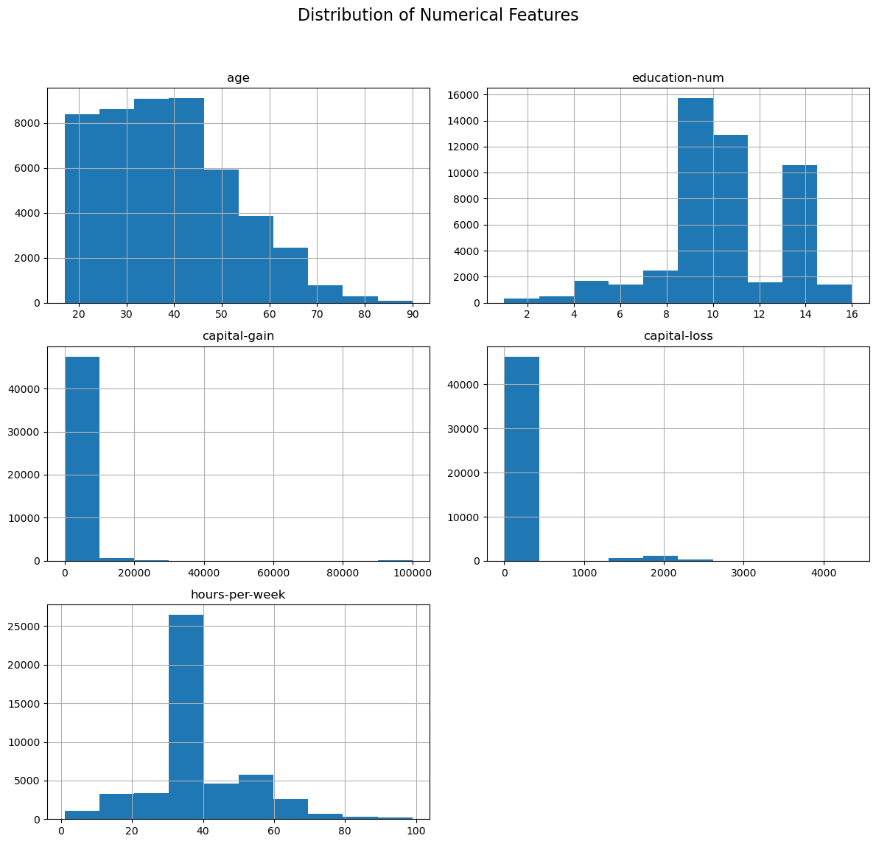
Observations :
- People above 8th grade are dominating the data.
- Capital-gain and Capital loss are distributed mostly around zero.
- More than Half of the people (~52%) are working between 30- 40 hours per week.
- The data consists mostly from people at the ages : 18-60.
- Generally, the data is very skewed.
Implications :
- Due to our data being very skewed, we should consider scaling it using standartization/normalization/another scaling algorithm.

Slide 26
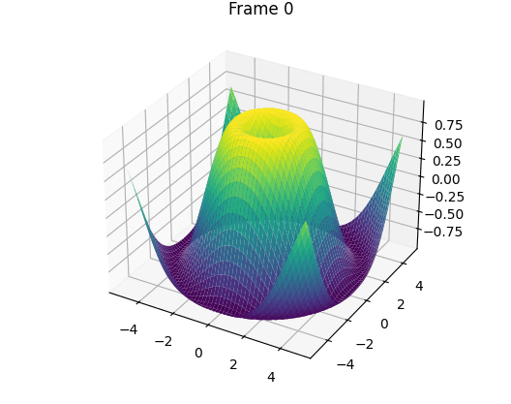
Plotting Multivariate Plots

Slide 27
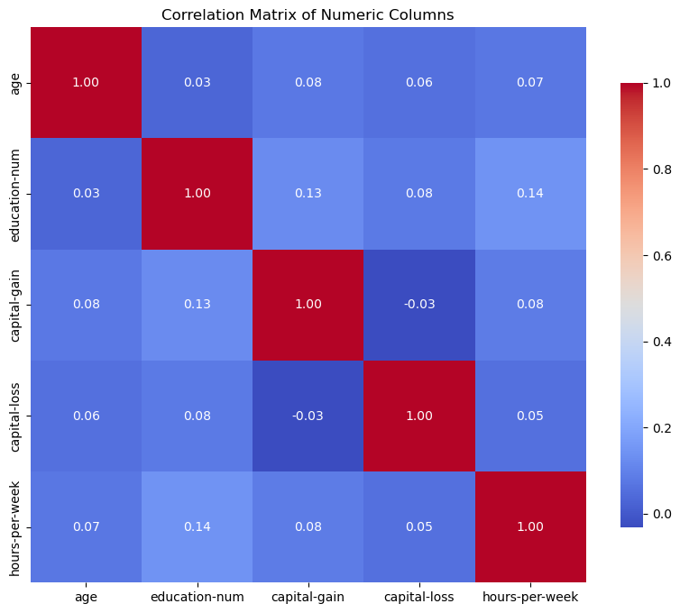
No meaningful correlation seen between numerical columns !

Slide 28

Violin Plots
We chose to use violin plots as a method of visualizing possible connections between our columns that we couldn’t otherwise see.
After trying many different bivariate plots, the violin plot seemed the best.

Slide 29
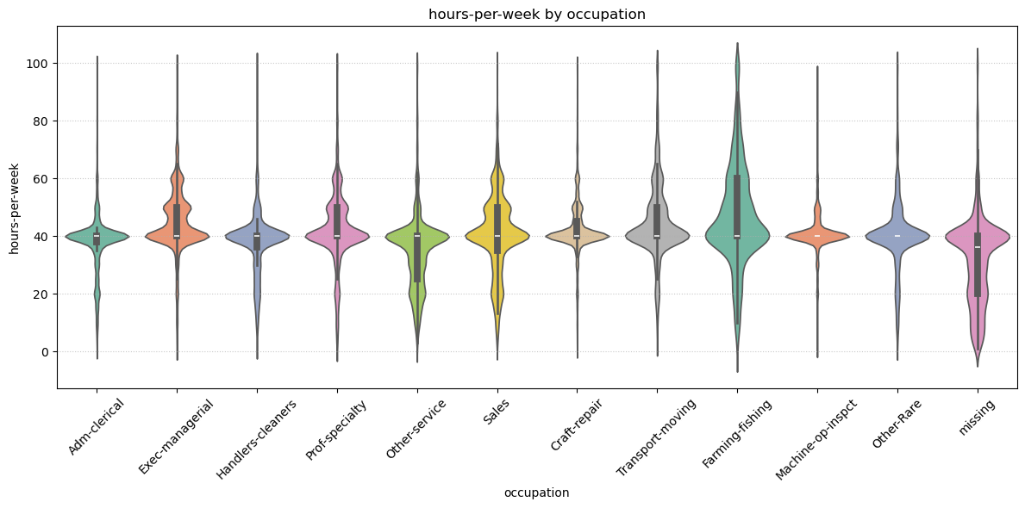
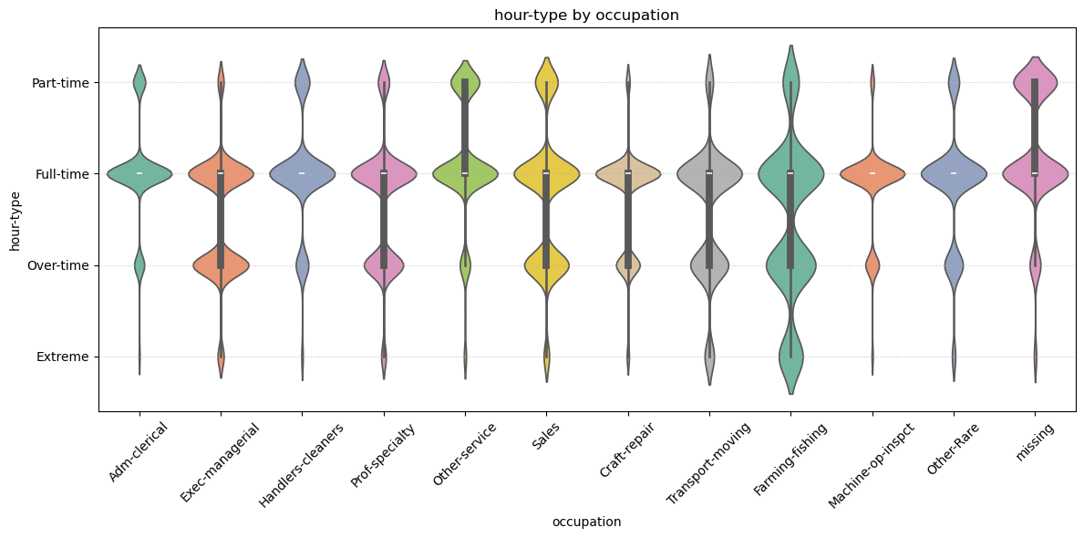
Hours per week by Occupation
Before
After
Observations:
- Feature Engineering
• We can create a new feature called “hour‐type”:
1. Part-time (< 30 hrs),
2. Full-time (30–45 hrs),
3. Overtime (45–60 hrs),
4. Extreme (60+ hrs).
• Then examine how each occupation/workclass falls into these hour‐type buckets. For instance, most Adm-clerical workers would land in “Full-time,” while many Exec- manegerial workers are in “Overtime” or “Extreme.”
After Feature engineering we can see the distributions more clearly

Slide 30
Steady 40-hour roles :
Adm-clerical, Handlers-cleaners, Sales, Other-service all show very tight violins around the “Full-time” bin, with only thin slivers of “Part-time” or “Over-time” and virtually no “Extreme” outliers.
Professional/managerial with some long hours :
Exec-managerial and Prof-specialty violins center on “Full-time” but have a noticeable bulge into “Over-time” and even into “Extreme” (60+ hrs), reflecting weekend work or high- responsibility roles.
Technical/trade mid-tier :
Craft-repair, Machine-op-inspct, Transport-moving: fairly broad spread from “Full-time” into “Over-time,” but only a few points in “Extreme.” This matches shift-work or on-call schedules.
Seasonal/peak demand :
Farming-fishing: the violin is skewed right, peaking well into “Over-time” and “Extreme.” That seasonal bulge shows bursts of 60–80 hr weeks.
Catch-all & unknown
Other-Rare: a very noisy, flat violin spanning all four hour types—this heterogeneous bucket indeed mixes every pattern.
missing: similar full-spectrum noise, confirming these unknown occupations could carry any hour profile.

Slide 31
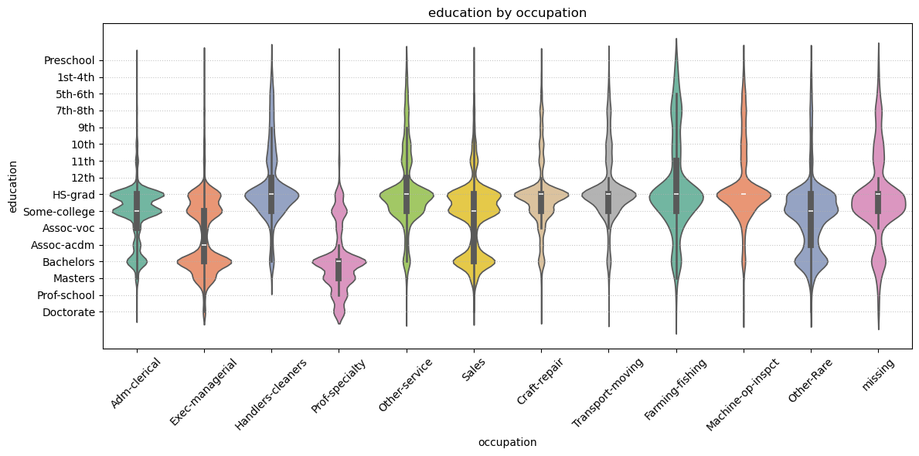
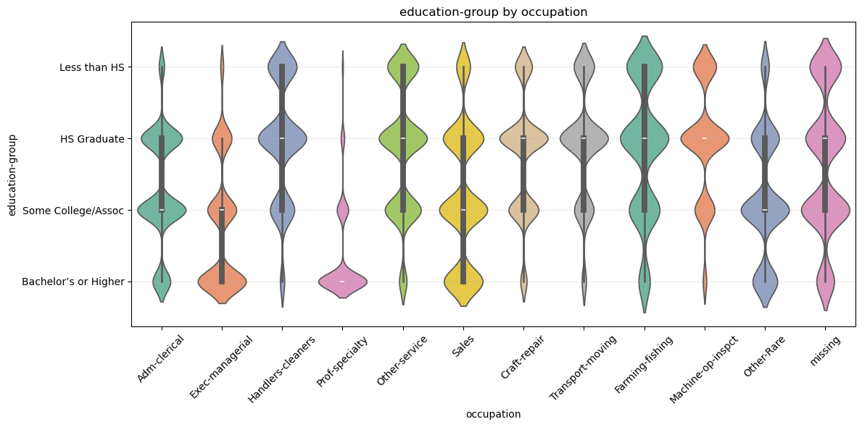
Education by Occupation
Before
After
Observations: - Low-education roles (Preschool–12th): Predominantly appear in Handlers-cleaners, Machine-op-inspct, and Transport-moving, with very thin densities in Exec-managerial and Prof-specialty.
- HS-grad: Found across all occupations but peaks in Sales, Other-service, and Adm-clerical, reflecting entry-level or administrative positions.
- Some-college/Associate (Some-college–Assoc-acdm/voc): Concentrated in Private, Exec-managerial, Sales, and Transport-moving, indicating that many mid-level roles require some post-secondary education.
- Bachelor’s or Higher: Densest in Exec-managerial, Prof-specialty, and Protective-serv, with a long right tail into Doctorate at Prof-specialty.
- missing (Unknown education): Sparse noise across all occupations—should be treated as “Unknown” or imputed.
Implications:
Education and occupation correlate strongly:
- Professional/Managerial roles almost exclusively require Bachelor’s or higher. - Blue-collar/Trade occupations (Machine-op, Handlers, Transport) skew lower (≤ HS or Some-college).
- Service roles (Sales, Other-service) span HS-grad through Bachelor’s.
Feature engineering :
We can encode an ‘education-group’ feature , then incorporate that alongside occupation to create joint feature interactions:
1. Less than HS : Preschool, 1st-4th, 5th-6th, 7th-8th, 9th, 10th, 11th, 12th
2. HS Graduate : HS-grad
3. Some College / Assoc : Some-college, Assoc-voc, Assoc-acdm.
4. Bachelor’s or Higher : Bachelors, Masters, Prof-school, Doctorate.

Slide 32
Observations:
Prof-specialty & Exec-managerial: Nearly 100 % “Bachelor’s or Higher,” with almost no “HS Graduate” or below.
Other-Rare: Broadly mixed across all four education buckets—reflects true heterogeneity.
Missing education: Lightly scattered in every occupation—worth flagging as its own category.
Implications:
Occupation–education interactions will sharply separate “high-skill” (Prof-specialty, Exec-managerial + Bachelor’s+) from “mid-skill” (Craft-repair, Adm-clerical + Some College/Assoc) and “low-skill”
(Handlers, Machine-op, Farming + < HS/HS) clusters.

Slide 33
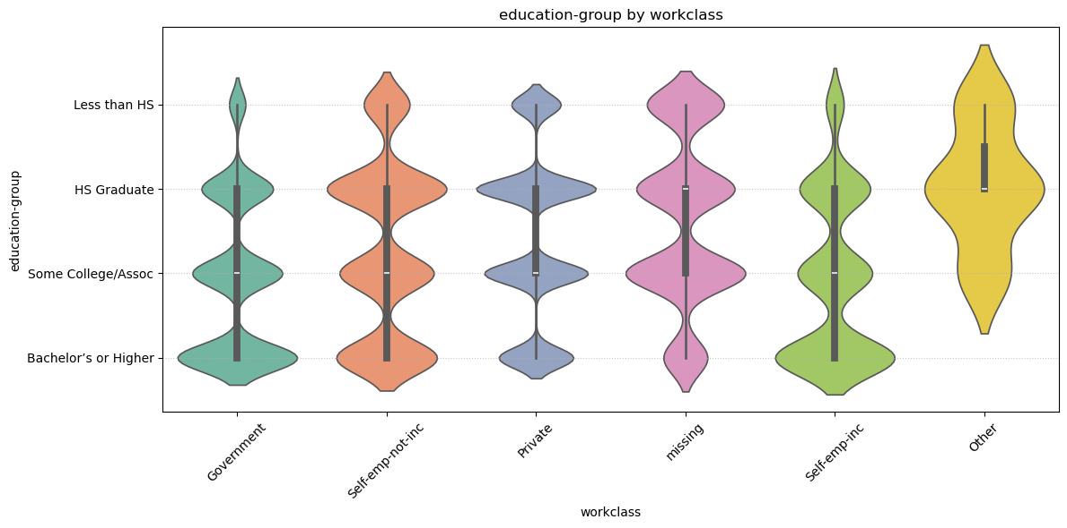
Education Group by Workclass
Observations:
Self-emp-inc (incorporated business owners) skew heavily toward Bachelor’s or Higher, with substantial density at Masters and some Doctorate, and very few in the <HS categories.
Government workers have a tight concentration at HS-grad and Bachelors, with a median around HS-grad–Some-college. Very few have below HS or advanced degrees.
Private sector has 2 peaks : a large peak at HS-grad/Some-college and a second peak at Bachelors, indicating many entry-to-mid-level education roles plus a professional subset.
Other (Without-pay/Never-worked) is spread across nearly all education levels, peaking at HS-grad but with noise—another sign that this bucket is noisy.

Slide 34
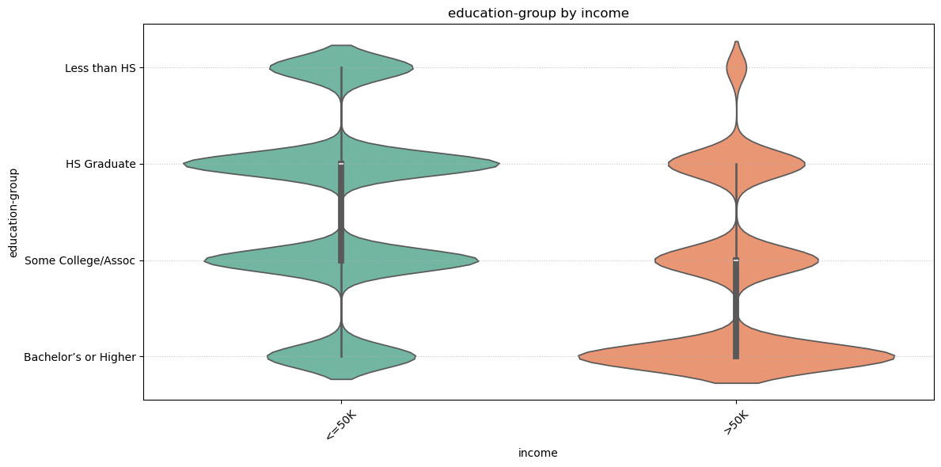
Education Group by Income
Observations
“ ≤50 K earners” :
Their education distribution peaks at HS Graduate, with a broad shoulder into Some College/Assoc.
There’s a noticeable tail of Less than HS, and very few with Bachelor’s+.
“ >50 K earners”:
Almost entirely dominated by Bachelor’s or Higher, with the widest density there.
A secondary hump at Some College/Assoc, a small bump at HS Graduate, and virtually none below HS.
Minimal overlap at extremes
Less than HS is almost exclusively in the ≤50 K group.
Bachelor’s+ is overwhelmingly in the >50 K group.
Some‐College is mixed : That bucket straddles both income levels fairly evenly, suggesting it’s a transitional zone.
Implications:
Education group is a clear separator of income classes, can be helpful for clustering.

Slide 35

Bivariate plots by Gender

Slide 36
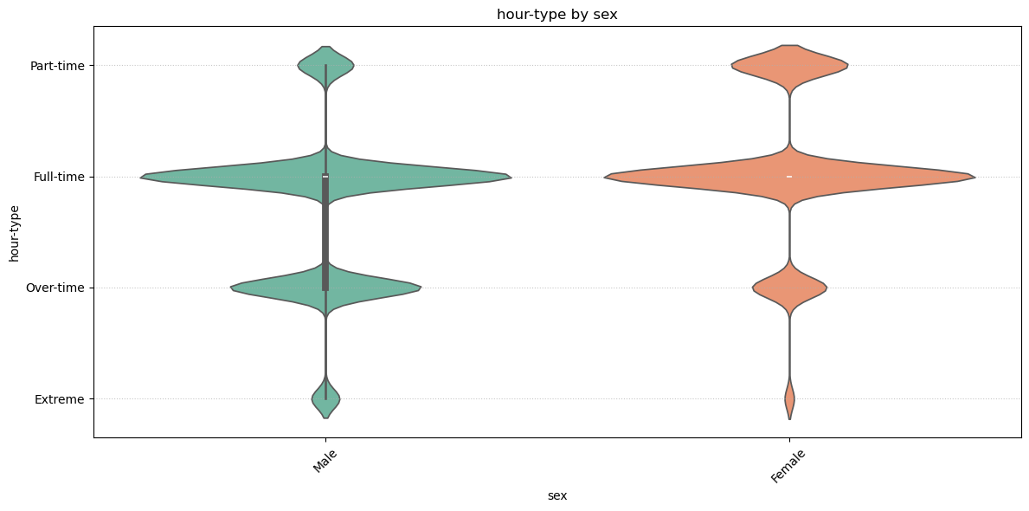
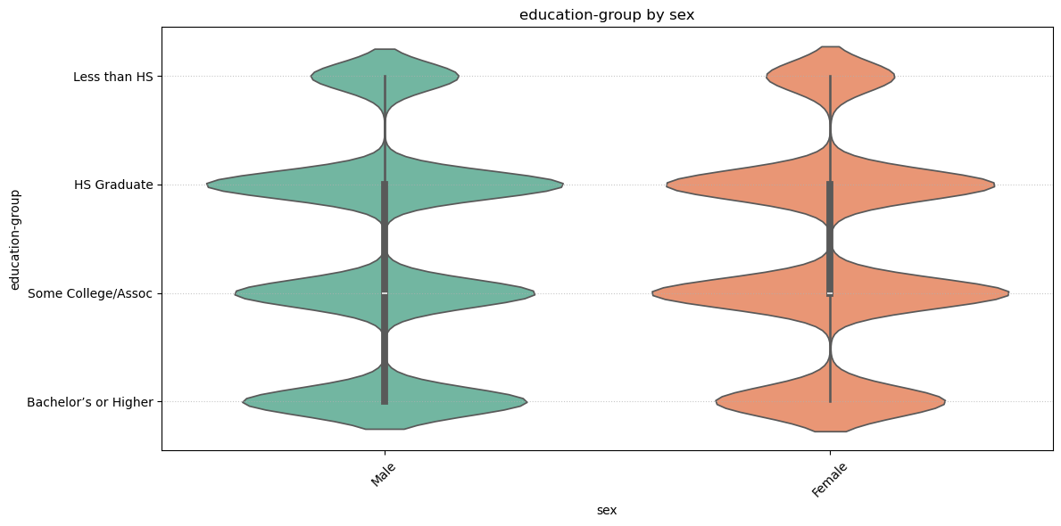
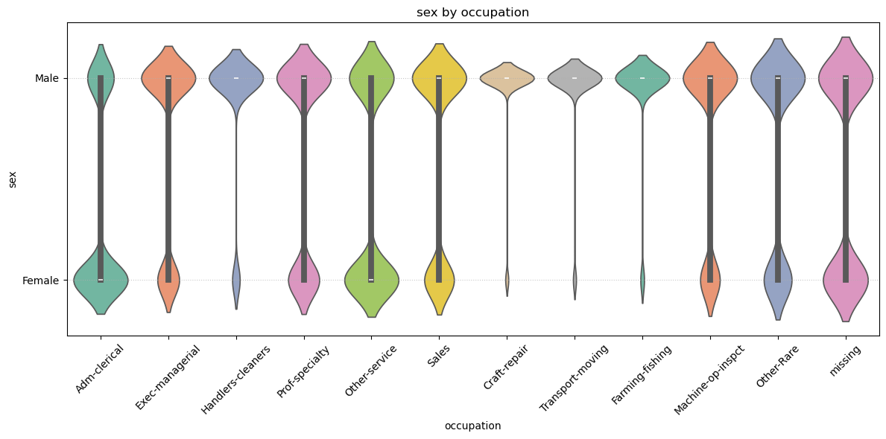
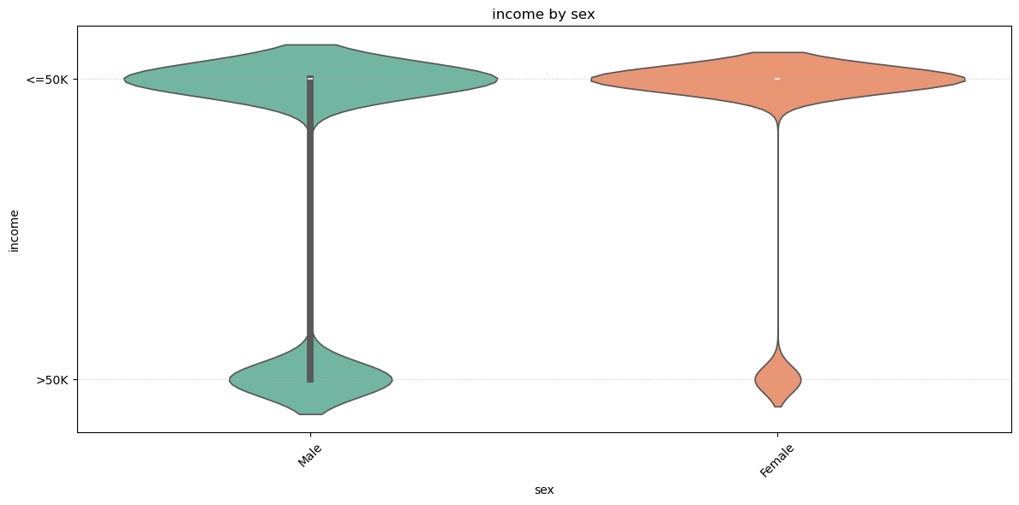
Hour-type by Sex • Full-time is the dominant category for both, but especially for men.
• Women have a noticeably thicker “Part-time” band.
• Overtime and Extreme hours appear more frequently among men.
Women outnumber men in the Some College/Assoc and Bachelor’s+ buckets; men have a thicker band at HS Graduate.
Both sexes show minimal “Less than HS,” but women’s violin is slightly wider there.
• The vast majority of both genders earn ≤50 K, with women even more concentrated there.
• Men have a relatively larger slice of the >50 K group.

Slide 37

Count plots by income

Slide 38
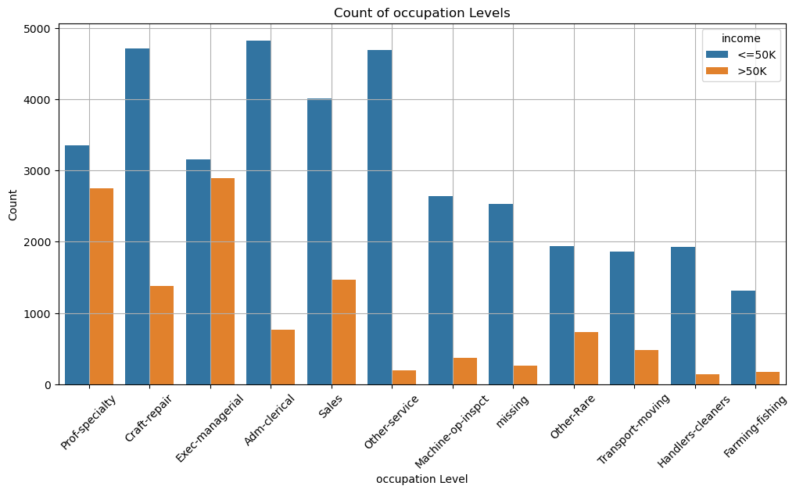
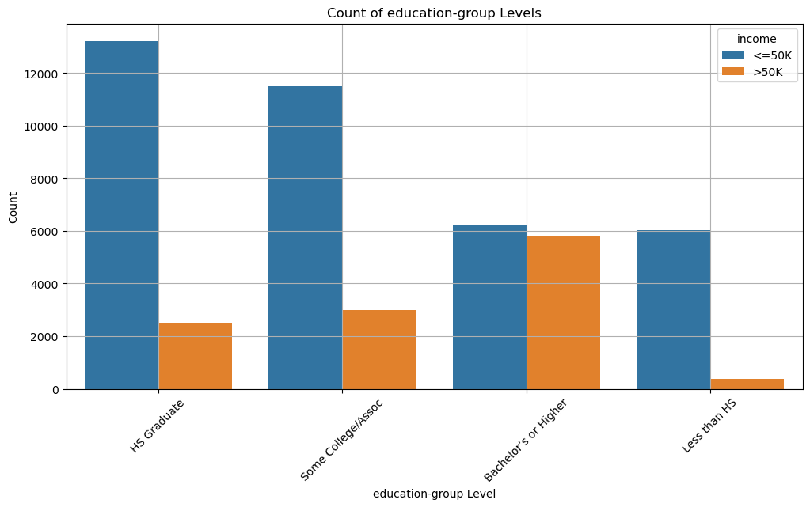
Observations : • High-income roles: Exec-managerial and Prof-specialty have the largest >50 K bars (≈2.8 K & 2.7 K) and nearly match their ≤50 K counts—these are almost parity professions.
• Mid-income tails: Craft-repair and Adm-clerical still skew heavily ≤50 K but carry meaningful >50 K tails (≈1.4 K and 0.8 K).
• Low-income occupations: Machine-op-inspct, Handlers-cleaners, Transport-moving, and Farming-fishing show very few >50 K earners (< 15 %), with their blue bars dwarfing
the orange.
• Mixed/unknown: Sales sits in the middle (≈4 K ≤50 K vs 1.5 K >50 K), while Other-Rare and missing occupations have negligible high-income representation.
Observations:
- We can see a clear correlation between education levels (Group-wise) and the number of records of '>50k'. (Less Than HS < HS Graduate < Some College/Assoc < Bachelor's or Higher)
- Feature engineering: Our four education buckets capture a strong monotonic relationship with income.
Implications
- Thought - Education as a key segmentation axis: Clusters will naturally separate into “Low-education low-earners,” “Mid-education mixed-earners,” and “High-education high-earners.”

Slide 39

Bivariate plots key observations
Our four education buckets capture a strong monotonic relationship with income.
Education group is a clear separator of income classes, can be helpful for clustering.
Education and occupation correlate strongly.

Slide 40

Outlier Detection

Slide 41
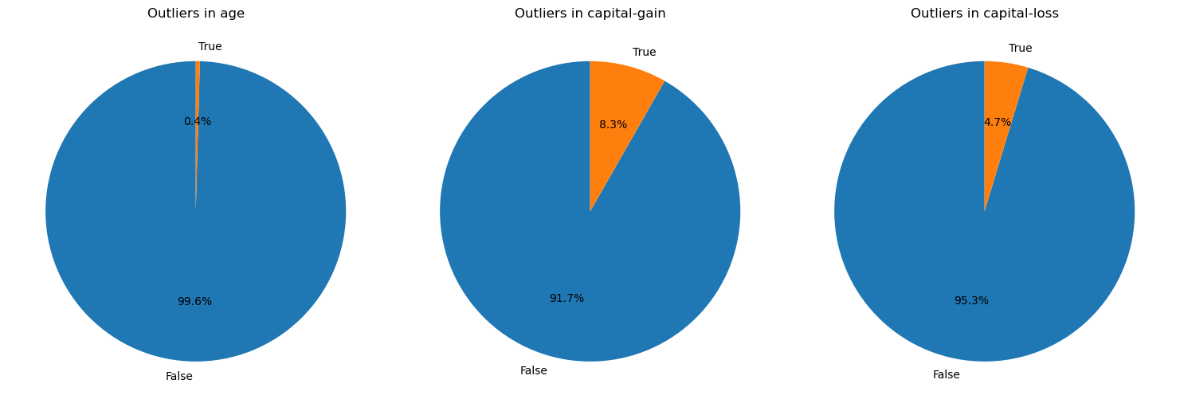
Using IQR method for finding outliers, we proceeded to analyze our numerical columns for outliers and got :
Column | Percentage
Age | 0.44%
Capital – gain | 8.3%
Capital - loss | 4.7%

Slide 42
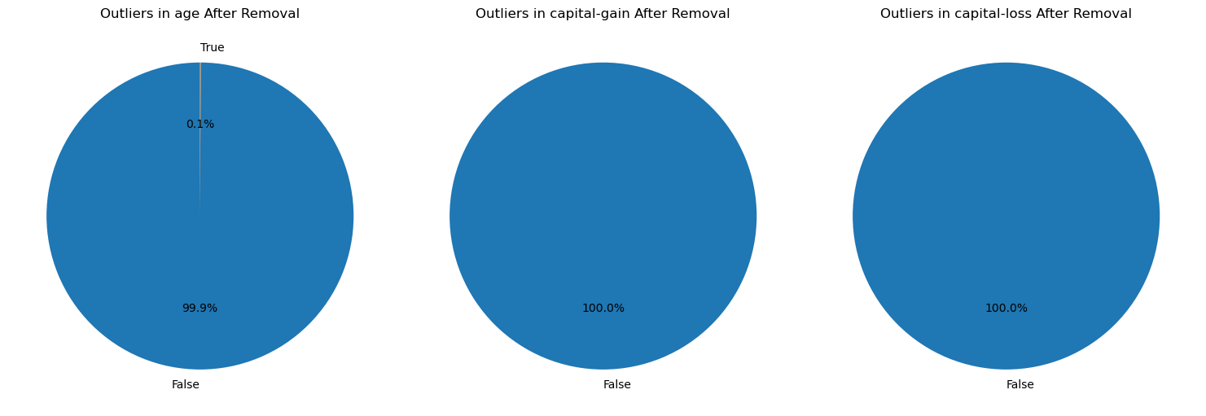
Because all of our outlier percentages were less than 10% we decided to mask them out and work with the cleaned data.

Slide 43
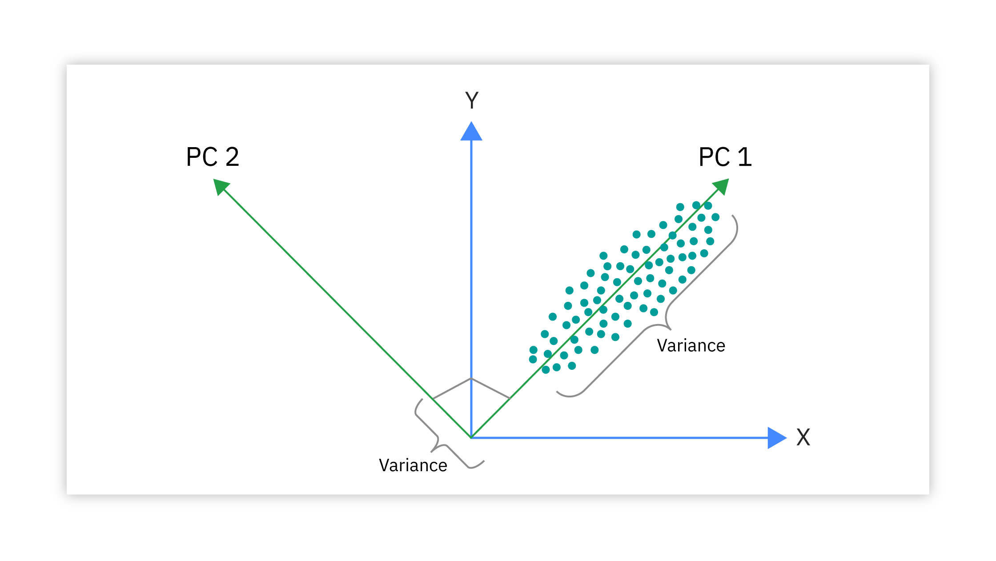
PCA
Principle Component Analysis

Slide 44
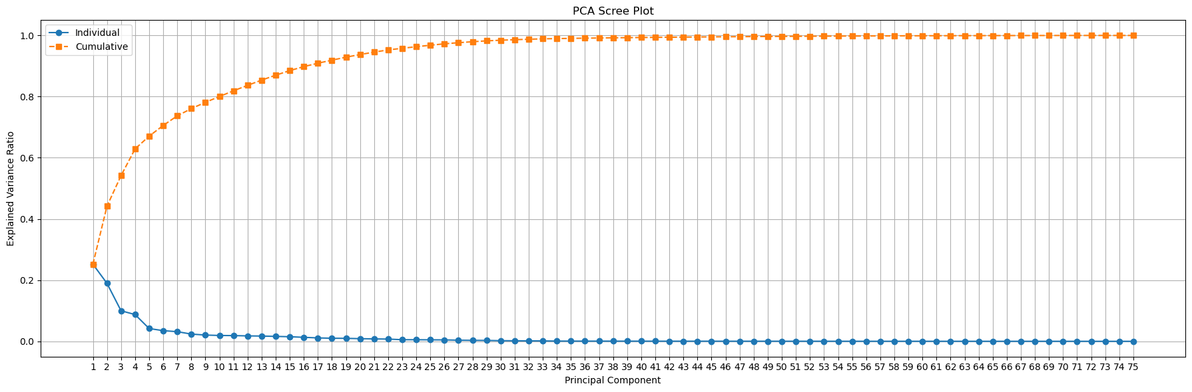
We’ve ran PCA on various variance thresholds from [0.70 – 0.90] got :
6 components explain ≥70% of variance.
10 components explain ≥80% of variance.
13 components explain ≥85% of variance.
17 components explain ≥90% of variance.
After multiple tries on 90% and 85% thresholds,
to be less objected to dimensionality problems we decided to do our PCA on 10 components, which means our 10 most significant components will capture 80% of the total variance.
>80%

Slide 45
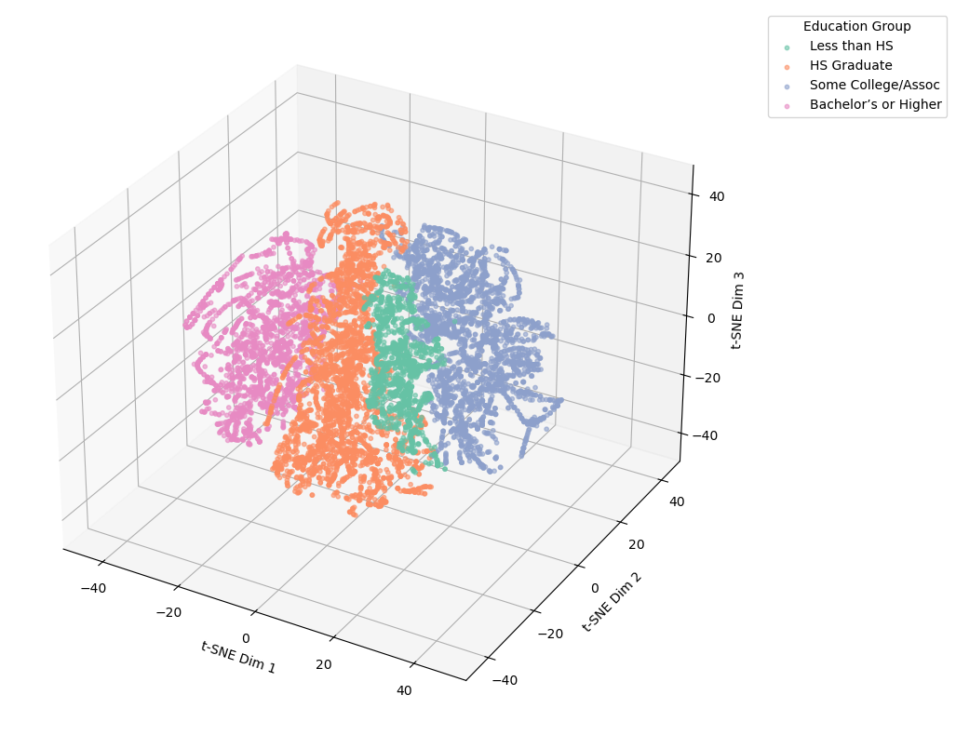
Because PCA assumes linearity, we ran T-SNE algorithm to be able to better visualize non-linear relationships and clusters.
This is a 3D T-SNE Visualization where the data is colored by Education Group.

Slide 46
Clustering Algorithms

Slide 47

K-means
How it works :
Partition N observations into K groups (clusters) so that points within each cluster are as similar as possible, and points in different clusters are as dissimilar as possible.

Slide 48
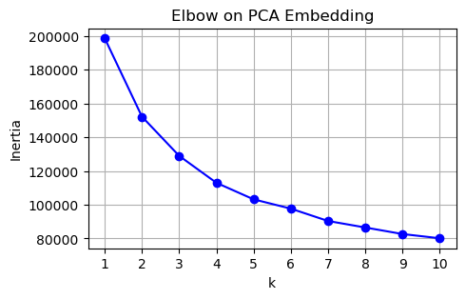
K-means
First, based on the elbow method we chose the best k, which is the number of clusters.
We chose k = 3 because :
Biggest drop by 3: Inertia drops sharply from k=1→2 and again from 2→3, but after k=3 the curve flattens—each additional cluster gives only a small gain.
Elbow point: The “knee” of the plot sits at 3, indicating the optimal trade-off between compactness and model simplicity.

Slide 49
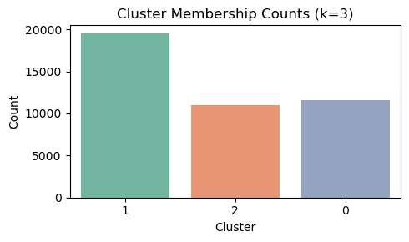
K-means
Running K-means with k=3 gave us 3 clusters :
Clusters ‘0’ and ’2’ are nearly the same size.
Cluster ‘1’ is nearly double the size of the other 2.
We went on to visualizing our cluster using scatterplots.

Slide 50
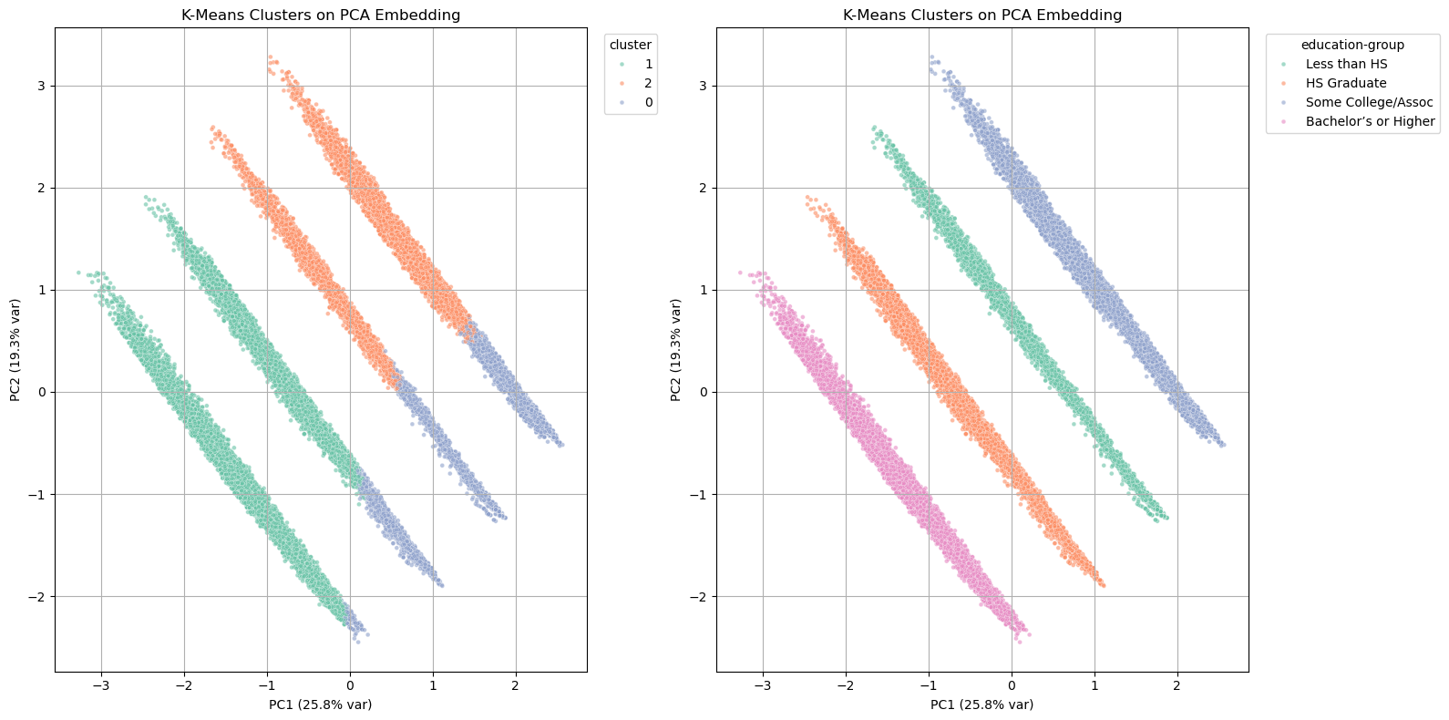
K-means
Here we can see 2 side by side scatter plots :
Left side – PCA embedded data colored by K-means clusters.
Right side – PCA embedded data colored by ‘Education – Group’ column.
Observations :
PC1 is almost perfectly ordered by education, so the left-to-right layout in 2D looks like four distinct stripes.
On a 2D PCA plot, our data looks like 4 stripes.

Slide 51
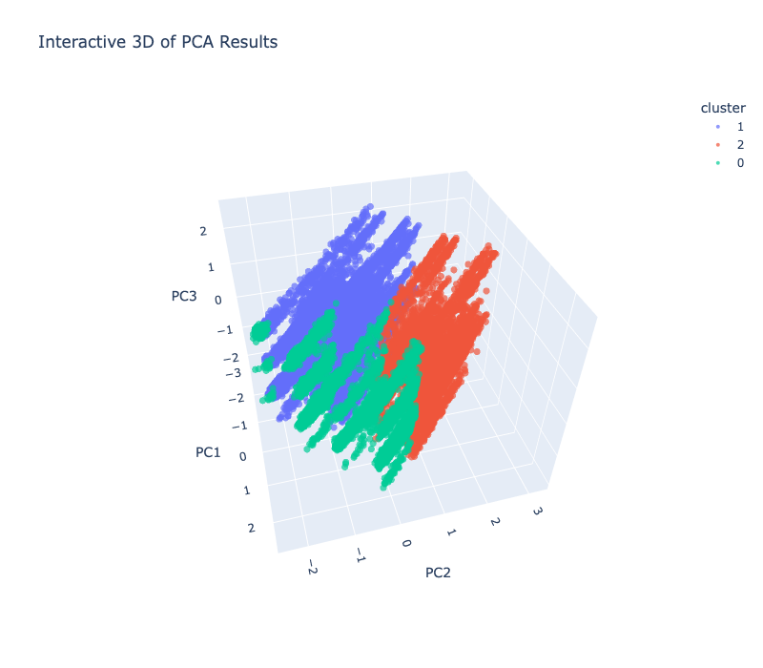
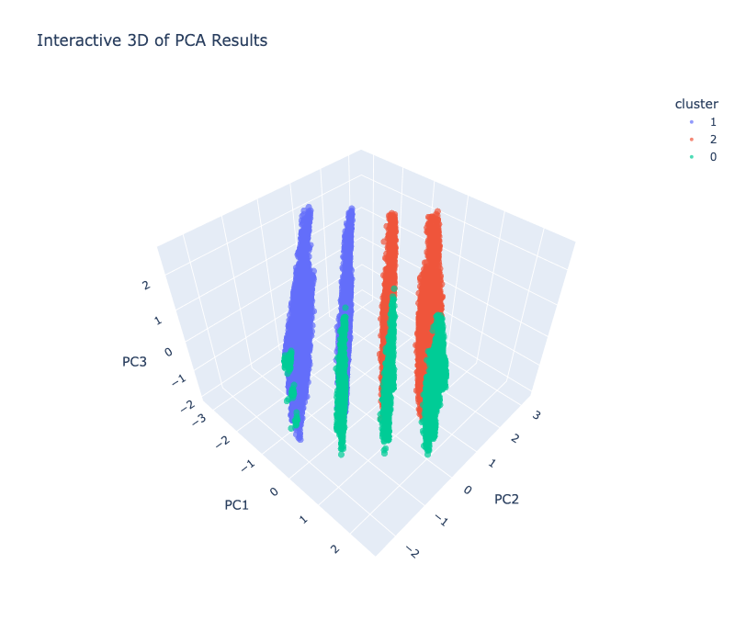
K-means
3D plots on PCA

Slide 52
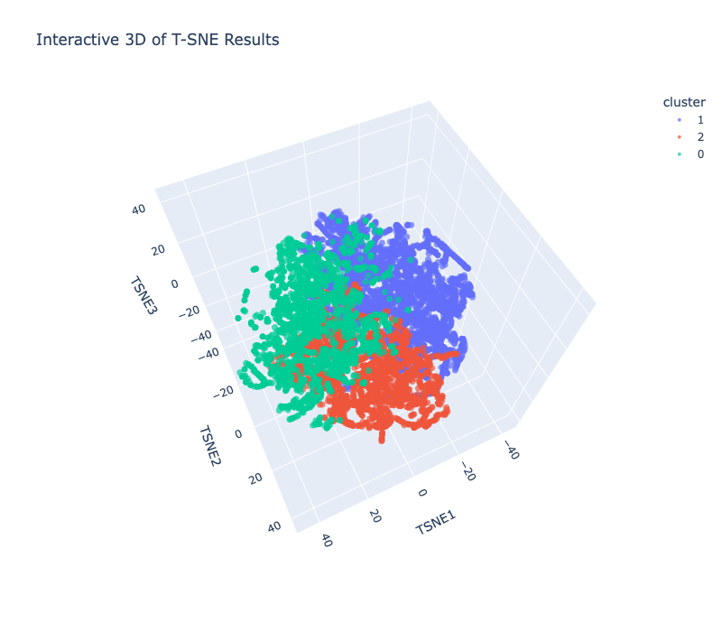
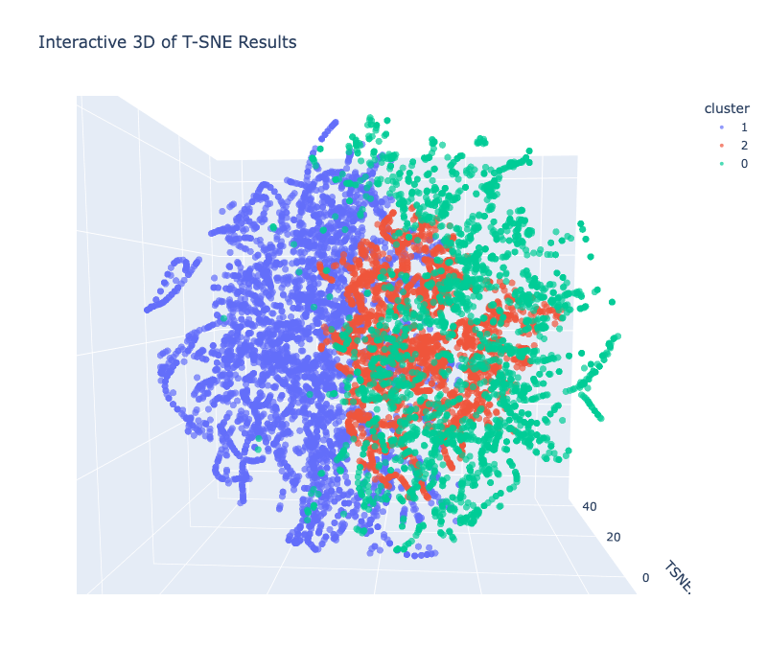
K-means
3D plots on T-SNE

Slide 53
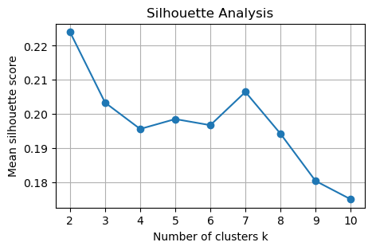
Silouette Scores
To evaluate how well clusters are separated and how cohesive they are we computed the silhouette scores.
We ran the test on different number of clusters :
We can see that for k = 3 we get the score of 0.203 which is considerd not very good, but in the context of our data we decided to further investigate the clusters we got.

Slide 54
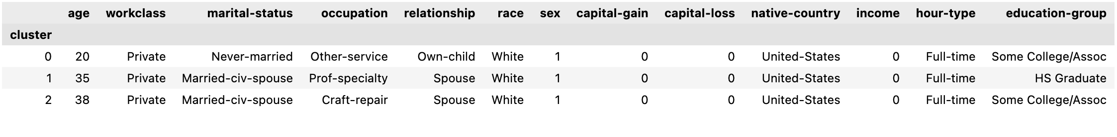
Cluster Profiles
Cluster 0: Young / Early-career Group
Observations:
• Age: overwhelmingly 19–23.
• Relationship: 5,942 “Own-child” and 3,557 “Not-in-family” – lots of dependents or very young adults.
• Education: “Some College/Assoc” (5,073) and “HS Graduate” (3,760) dominate, with 2,580 “<HS.”
• Income: virtually no one > 50 K (63 of ~11 570), so nearly 100 % low earners.
• Work & Hours: mostly Private or Government, heavy part-time (3,088) and full-time (6,921), very little overtime/extreme.
Implications:
• This cluster is primarily minors or early-career individuals with limited earning power.
• Upskilling or educational interventions could shift many into higher-earning clusters.

Slide 55
Cluster Profiles
Cluster 1: Mid-career Professionals & Managers
Observations:
• Age: concentrated in mid-30s (33–38).
• Marital & Family: 10,820 “Spouse” relationships and 10,943 married-civil-spouse.
• Occupation & Education: top roles are Prof-specialty (3,749) and Exec-managerial (3,020); education is split between HS-grad (10,288) and Bachelor’s+ (9,226).
• Income: ~28 % earn > 50 K (5,556 of 19,514).
• Workclass & Hours: mostly Private (12,946) or Government (3,248), heavy full-time (11,726) and overtime (5,508).
Implications:
• This is the “core” professional segment—stable careers, family households, moderate to high incomes.
• They’re prime candidates for premium financial products or advanced training.
• Clustering labels like “High-skill Professional” fit this group well.

Slide 56
Cluster Profiles
Cluster 2: Mid-career Technical & Trade
Observations:
• Age: centered on late 30s to early 40s (36–42).
• Occupation: Craft-repair (1,895), Exec-managerial (1,301), Adm-clerical (1,269), Sales (1,062).
• Education: overwhelmingly “Some-College/Assoc” (7,749) and “<HS” (3,273), no HS-grad or Bachelor’s+ in top five.
• Income: ~21 % earn > 50 K (2,361 of 11,022).
• Workclass & Hours: mostly Private (7,478) or Government (1,495), strong full-time (7,061) and overtime (2,569).
Implications:
• This cluster reflects seasoned trades and mid-level service roles with post-secondary certificates.
• There’s clear upside potential: targeted upskilling (e.g. technical certifications) could boost many into the Cluster 1 profile.
• Labeling it “Technical / Service Mid-Skill” to highlight its blend of trade and administrative jobs.

Slide 57
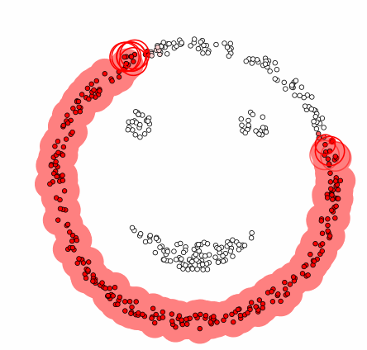
DBSCAN
DBSCAN (Density-Based Spatial Clustering of Applications with Noise) is a powerful clustering algorithm that groups points based on density — not distance to a centroid like K-Means.

Slide 58
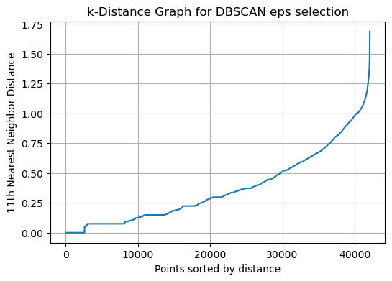
DBSCAN
DBSCAN uses two main parameters:
ε (epsilon): Radius of neighborhood around a point.
minPts: Minimum number of points required to form a dense region.
We chose minPts as number of dimensions + 1 (common rule of thumb)
To decide on the right epsilon we used a k-distance graph, and determined the right epsilon by the elbow of it.
minPts = 11
ε = 0.982
Elbow

Slide 59
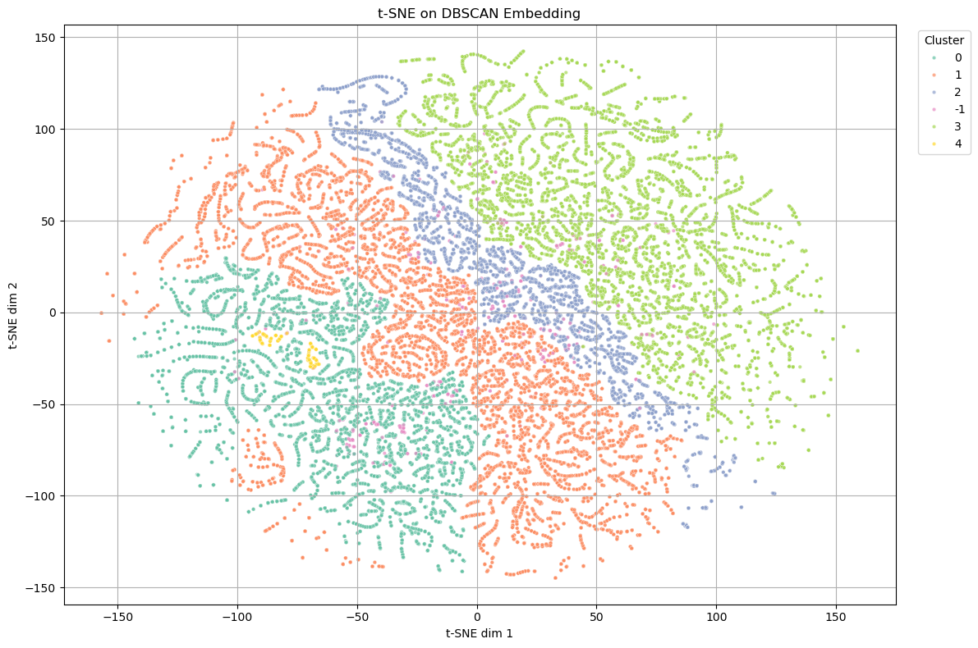
DBSCAN
DBSCAN T-SNE plot :

Slide 60

DBSCAN
DBSCAN PCA plot :

Slide 61

DBSCAN
After tweaking the minPts and epsilon, we gor a nice looking plot og the clusters, but when we computed the average silhouette score we got a very low score of 0.064.
Which is why we concluded that DBSCAN doesn’t work well on our data and moved on to trying Hierarchical Clustering.
Towards Hierarchical Clustering

Slide 62

Hierarchical Clustering
Hierarchical clustering builds a tree-like structure (called a dendrogram) that shows how data points can be grouped at different levels of granularity.

Slide 63

Hierarchical Clustering
We have tried the Agglomerative method which starts with individual point as clusters, and merges them step by step.
Hierarchical clustering uses Linkage criteria for merging clusters.
We tried : single, complete, average and Wards method.
The best result was using Ward’s method which tries to minimize the increase in total within cluster variance.

Slide 64
Hierarchical Clustering
We chose n = 3 clusters and proceeded towards visualizing.

Slide 65


Hierarchical Clustering
We can see overlaps in our cluster, which suggests that our silhouette score wont be so high.
Cluster sizes seem somewhat close to each other.

Slide 66


Hierarchical Clustering
PCA plots

Slide 67

Silouette Scores
We computed the average silhouette score for Hierarchical clustering.
We got silhouette score of : 0.17599 for our 3 clusters, which is considered low.
After trying different types of clustering algorithms, we found that for high dimensional data it can be better to use cosine distance metric instead of Euclidian.
So we went on to try K-Means and Hierarchical Clustering with cosine distance metric.
Towards ‘cosine’ metric Clustering

Slide 68



Cosine K-means
We have run K-Means on k = 3.
Cluster sizes look good. Clusters ‘1’ and ’2’ are almost the identical size.
T-SNE and PCA plots show us that there is an overlap between the clusters, suggesting a not very high silhouette score.
After running a silhouette score test we got a silhouette score of 0.251 which is ~25% higher than K-Means with Euclidian distance metric.
We concluded that this is a good sign and we will try to run a Hierarchical clustering with cosine distance to see if the score can get better.
T-SNE
PCA

Slide 69

Cosine Hierarchical Clustering
We have tried the Agglomerative method which starts with individual point as clusters, and merges them step by step.
To use the cosine distance metric we needed to normalize the values and use Average linkage method which looks at the average pairwise distance between two clusters before merging.
We chose n = 3 clusters and proceeded towards visualizing.

Slide 70



Cosine Hierarchical Clustering
We have run HC on n = 3 clusters.
T-SNE plot looks better than all of the plots before, we have clear separation between clusters with small overlaps.
PCA looks not so good, a lot of overlap between clusters.
After running a silhouette score test we got a silhouette score of 0.3316 which is almost 2x higher than HC with Euclidian distance metric, and overall this is our best result yet.
We then tried to run this algorithm on PCA embedding of 85% variance with motivation to get even higher score, but got a score of 0.297.
T-SNE
PCA
Silhouette Score : 0.3316

Slide 71

Cluster Profiling

Slide 72
Cluster Profiles
Cluster 0: Entry-Level Administrators
Observations:
• Age: on average ~36 years old (median 33), but the single most common age is 23.
• Work & Family: overwhelmingly Private-sector, full-time, in Adm-clerical; most are never-married and not-in-family.
• Education: mode = HS-Graduate, with very low capital-gain/loss and income flag (~6 % have any gain, almost none > 50K).
• Demographics: almost all White, ~46 % female (sex_mean ≈ 0.46).
• Income: income_mean ≈ 0.058 means only about 6 % fall into the high-income (> 50K) bracket.
Interpretation:
This is a young, entry‐level administrative cohort—mostly high-school grads, full-timers in clerical roles, very low capital gains, and low rates of high income.

Slide 73
Cluster Profiles
Cluster 1: Early-Career Associates
Observations:
• Age: on average ~35 years old (median 33), most common age = 20.
• Work & Family: also Private and full-time in Adm-clerical, but these tend to be spouses rather than independent “not-in-family.”
• Education: mode = Some College/Assoc, with somewhat higher capital-gain frequency (13 % have any positive gain) and a higher high-income rate (~13 %).
• Demographics: still predominantly White, but more skewed female (sex_mean ≈ 0.64).
Interpretation:
A younger, post-secondary-educated administrative cohort—many college/associate attendees, higher female representation, moderate capital gains, and moderate (≈13 %) high-income attainment.

Slide 74
Cluster Profiles
Cluster 2: Mid-career Professionals
Observations:
• Age: older, average ~43 years (median 42), mode age = 38.
• Work & Family: mostly Private, full-time, but in Prof-specialty roles; nearly all are married-civ-spouse with the “spouse” relationship.
• Education: mode = HS-Graduate (surprising, but note many may have “HS-Graduate” highest degree but professional roles), and this cluster has the highest capital-gain incidence (42 % have positive gains) and high-income rate.
• Demographics: again mostly White, ~89 % male (sex_mean ≈ 0.89).
Interpretation:
mid-career professionals—older, married, in specialized roles, with substantial capital gains and the highest rate of > 50K earners.

Slide 75
Summary

Slide 76
Algorithms used :
Algorithm | Metric | Number of clusters | Silhouette score
K-means | Euclidian | 2 | 0.224
K-means | Euclidian | 3 | 0.203
K-means | Cosine | 3 | 0.251
DBSCAN | Euclidian | 5 | 0.064
Hierarchical Clustering | Euclidian | 3 | 0.17599
Hierarchical Clustering | Cosine | 3 | 0.3316

Slide 77
Methods and Results
EDA : identifying missing values, imputing ‘?’ values with missing/mode/median, removing outliers using IQR method
Visualization : count-plots, scatter-plots(2D,3D), violin-plots, correlation-matrix, cat-plots
Feature Engineering : Adding new grouped columns (education-group,hour-type), transforming category columns to binary.
Scaling and Encoding : using One-Hot/Ordinal Encoding to transform categorical data to numerical for clustering algorithms. Normalizing the data for the use of cosine distance metric.
Applying Algorithms : Using different algorithms, and different methods within each algorithm to get to the best result.
Using critical and analytical thinking to make descisions regarding the work process on a big dataset. Tweaking algorithms to be more efficient.
Researching the internet for examples and answers to new questions that arose during the proccess.
Learning new algorithms from hands-on experience.
Learning to work in a group, dividing the work and utilizing time efficiently.
Dealing with new and hard problems.

Slide 78
Summary
Given the data we got, and our research question : “How can clustering analysis be applied to population data to form meaningful groups based on employment patterns and education level?”
We can say that :
Clustering can be applied to a population data using :
Selecting key education and employment features.
Reducing dimensionality to capture 80 % of variance while preserving structure.
Normalizing for cosine-style comparisons.
Applying a Hierarchical Agglomerative Clustering with average linkage + cosine metric on the L₂-normalized PCA-80% embedding to determine clusters .
We discovered three interpretable segments that directly reflect differences in education level (HS-Graduates vs Some-College/Assoc vs professional–role backgrounds) and occupational specialization (administrative vs craft‐repair vs professional‐specialty), along with diverging capital-gain and demographic patterns—while all work full time, it’s their role, education and financial profiles that really set them apart.

Slide 79
Summary
Implications:
Our results can be seen as a blueprints to any population dataset with similar features.
We thought that based on this type of analysis, by segmenting residents according to their education background and job profiles, cities or governments can tailor workforce development offerings:
Cluster 0 (high-school grads in clerical roles) → foundational digital and administrative skills workshops
Cluster 1 (some-college associates balancing part- and full-time hours) → flexible, family-friendly certificate programs
Cluster 2 (mid-career professionals in specialty roles) → leadership development and advanced financial planning courses
Using routinely collected census data in this way ensures that each program is offered to the citizens most likely to benefit—maximizing both uptake and impact.

Slide 80
Thank you !

